Slide 1
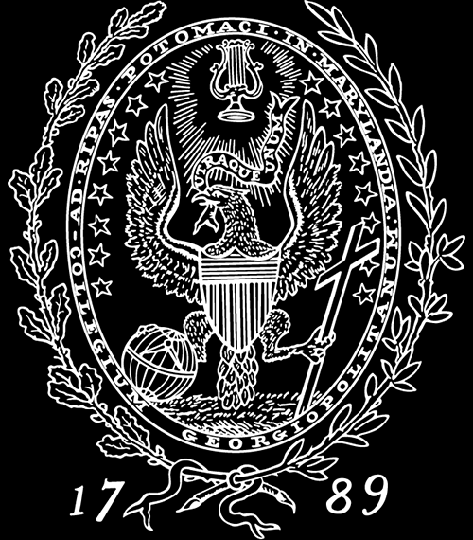
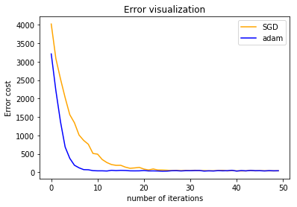
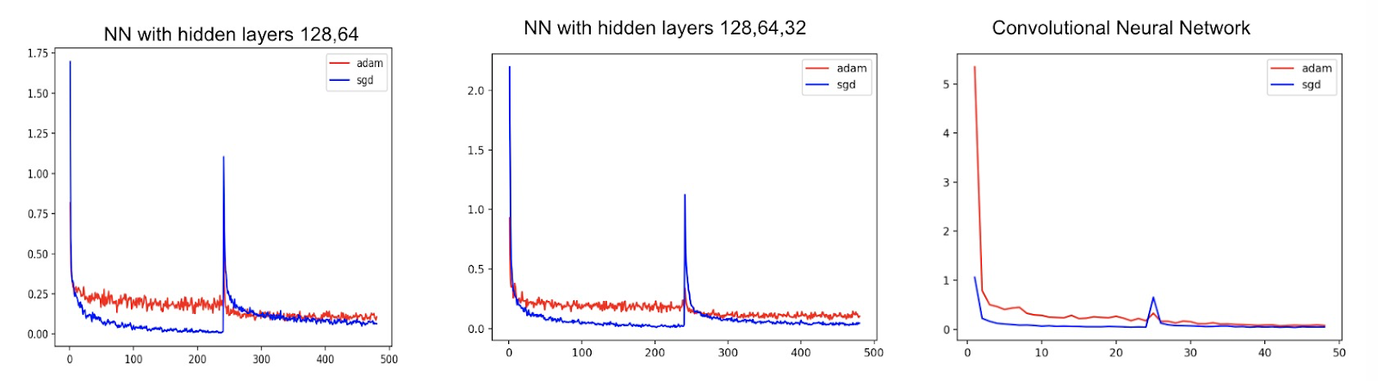
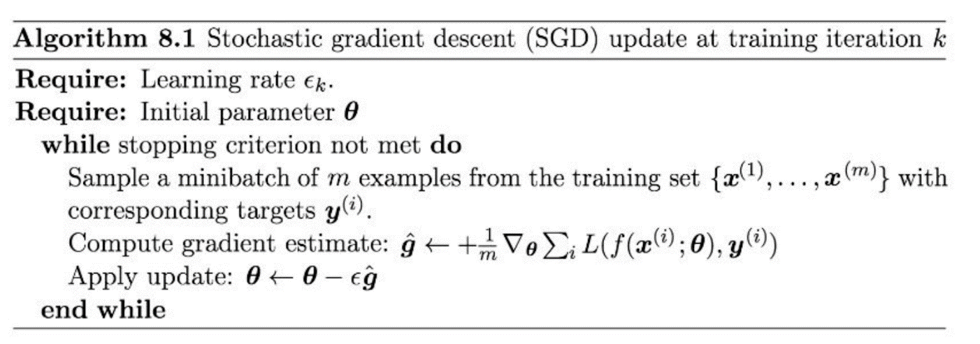
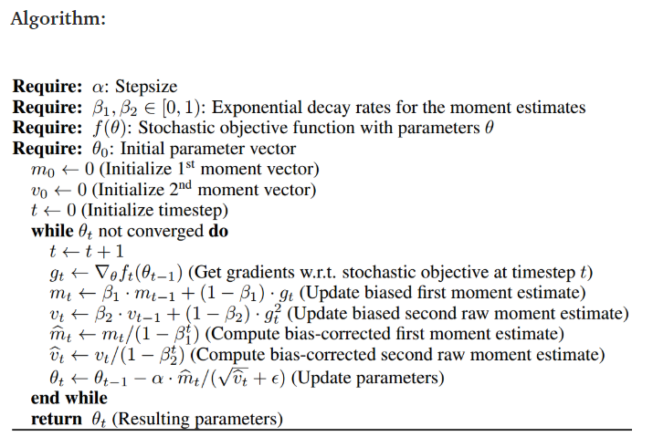
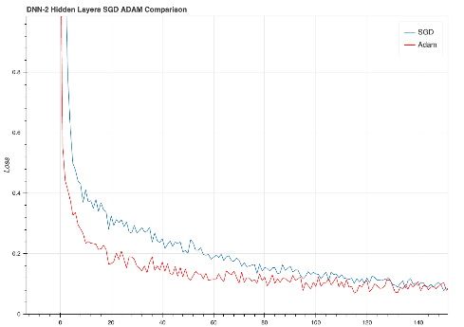
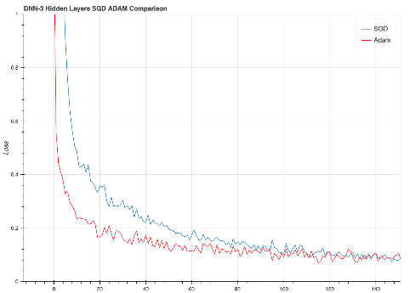
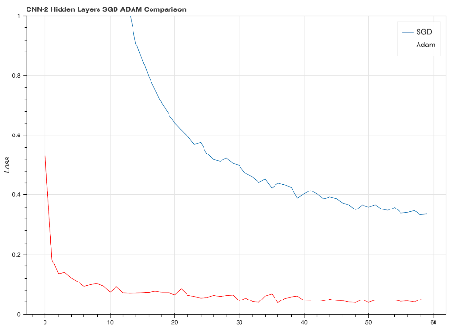
Adam for Neural Networks with Different Structures and Pruning Methods
Shengye Hang, Youyou Xie, Zhengrong Gu, Xuechun Wang
Georgetown University
INTRODUCTION
And Adamax, variant of Adam based on the infinity norm, is a first-order gradient-based optimization method. Due to its capability of adjusting the learning rate based on data characteristics, it is suited to learn time-variant process, e.g., speech data with dynamically changed noise conditions. In contrast to the SGD, Adamax offers the important advantage of being much less sensitive to the choice of the hyper-parameters (for example, the learning rate). Also, Adamax can quickly adapt to new conditions but tends to forget things quickly as well.
Some of Adam’s other advantages are that the magnitudes of parameter updates are invariant to rescaling of the gradient, its stepsizes are approximately bounded by the stepsize hyperparameter, it does not require a stationary objective, it works with sparse gradient, and it naturally performs a form of step size annealing[1].
Performance on Pruned Neural Networks
Deep learning is one of the topics where optimization methods are most frequently used. Neural networks are complicated systems when computers try to find the optimal point. Moreover, neural networks may have several hidden layers or other extensive methods like convolutional kernels, which increase the difficulties for finding the proper optimization algorithms. Many researchers may find it confusing when tuning the networks, some may encounter gradient explosion or gradient vanishing problems using different parameters. Therefore, it is essential to find out how different optimization methods perform on different structures, which is the project’s focus.
In fact, Adam, which refers to the stochastic optimization method which involves a changing learning rate based on the previous steps, is a new trend in neural networks optimization. The project will first sum up the ideas behind the novel algorithm, then compare it with the well-known “stochastic gradient descent” on a simple dataset to illustrate its strengths and drawbacks. Finally, the two optimization methods will be applied to neural networks with different hidden layers, different structures(using CNN) and even with pruning methods.
In most cases, a multiple-layer neural network will have thousands of parameters, which will waste the space and memory of the computer. Hence, pruning methods are necessities for trained neural networks. We use the algorithm suggested in [2] and [3] to perform the pruning process on exactly the same three models in the 4th section on the MNIST. (SGD with momentum parameter equals 0.9.) The model will first be trained on the defined layers. Then the connections between two layers which are weighted below a certain threshold will be eliminated. In this case, the new neural networks will not be fully connected, which means that some of the neurons between different layers are not associated. The training losses are shown below. And you can find the test accuracy and other information in the table.
We can see from the figure that Adam always converges faster when neural networks are retraining after pruned, while the final accuracies after retraining are similar. However, it is not always the case that Adam is a more efficient algorithm, as we can see that the loss of SGD may be lower after large amounts of the steps. A possible explanation for this is that the shrinkage of learning rate happens in the optimization process[4].
General Implementation of SGD and Adam
Performance on different Neural Networks
Non-Convex Problem
Stochastic Gradient Descent:
It updated the weights based on each training sample, not the batch as a whole as done in gradient descent.
Pros:
SGD is computationally less demanding than gradient since we don’t have to run through the whole training set to update the weights.
Cons:
converges slower than newer algorithm
Although SGD minimizes loss faster, it generates larger noise and oscillates around the minimum, resulting in different accuracy and operating losses.
In the next step, we will compare the performance of different optimizer on a multi classification neural network problem. We will work on the problem of handwriting number recognition using the Mnist data sets. We built three different neural networks and compare the optimization process on the model parameters using ADAM and SDG optimizer. The three neural networks we used are: DNN with two hidden layers, DNN with three hidden layers and CNN with 2 hidden layers. The corresponding model structures are listed as below:
Adam
Gradient descent is one of the most popular algorithms to perform optimization and by far the most common way to optimize neural networks. At the same time, every state-of-the-art Deep Learning library contains implementations of various algorithms to optimize gradient descent (like Lasagne's, Caffe's, and Keras' documentation). This introduction aims at providing you with intuitions towards the behaviour of different algorithms for optimizing gradient descent, especially Adam. We are first going to talk about what is Adam. We will then briefly summarize related algorithms such as RMSProp, AdaGrad, SGD. Finally, we will consider additional algorithm such as Adamax and discuss more advantages Adam have in solving practical deep learning problems.
Adam is an algorithm for first-order gradient-based optimization of stochastic objective functions, based on adaptive estimates of lower-order moments. It is a versatile algorithm that scales to large-scale high-dimensional machine learning problems. We can investigate different popular machine learning models, including logistic regression, multiplayer fully connected neural networks and deep convolutional neural networks to evaluate its performance. Based on the result of Adam: A Method for Stochastic Optimization, we can see that Adam outperforms RMSProp, Adagrad and SGD methods in solving practical deep learning problems.
Adam can converge faster than other methods and cost less. In logistic regression, Adam may yield similar convergence as SGD with momentum but both converge faster than Adagrad. While in some situations, Adam outperforms SGD with Nesterov momentum by a large margin both with and without dropout noise and Adam converges as fast as Adagrad. Adam also outperforms other methods. In convolutional neural networks, although both Adam and Adagrad make rapid progress lowering the cost in the initial stage of the training, Adam eventually converges considerably faster than Adagrad for CNNs. Also, though Adam shows marginal improvement over SGD with momentum, it adapts learning rate scale for different layers instead of hand picking manually as in SGD.
Adam performed equal or better than RMSProp, regardless of hyper-parameter setting. In experiment of bias-correction term, removal of the bias correction terms results in a version of RMSProp. RMSProp with momentum generate its parameter updates using a momentum on the rescaled gradient; whereas Adam updates are directly estimated using a running average of first and second moment of the gradient. RMSProp also lacks a bias-correction term; this matters most in case of sparse gradients, since in that case not correcting the bias leads to very large stepsizes and often divergence.
DNN-2-Layers:
Sequential(
(0): Linear(in_features=784, out_features=128, bias=True) (1): ReLU()
(2): Linear(in_features=128, out_features=64, bias=True) (3): ReLU()
(4): Linear(in_features=64, out_features=10, bias=True) (5): LogSoftmax() )
DNN-3-Layers:
Sequential(
(0): Linear(in_features=784, out_features=128, bias=True) (1): ReLU()
(2): Linear(in_features=128, out_features=64, bias=True) (3): ReLU()
(4): Linear(in_features=64, out_features=32, bias=True) (5): ReLU()
(6): Linear(in_features=32, out_features=10, bias=True) (7): LogSoftmax() )
ConvNet(
(layer1): Sequential( (0): Conv2d(1, 32, kernel_size=(5, 5), stride=(1, 1), padding=(2, 2)) (1): ReLU() (2): MaxPool2d(kernel_size=2, stride=2, padding=0, dilation=1, ceil_mode=False) )
(layer2): Sequential( (0): Conv2d(32, 64, kernel_size=(5, 5), stride=(1, 1), padding=(2, 2)) (1): ReLU() (2): MaxPool2d(kernel_size=2, stride=2, padding=0, dilation=1, ceil_mode=False) )
(drop_out): Dropout(p=0.5, inplace=False) (fc1): Linear(in_features=3136, out_features=1000, bias=True) (fc2): Linear(in_features=1000, out_features=10, bias=True) )
Method | Model | Test acc | Pruned acc | Retrained acc | Para Num | Pruned rate
ADAM | 128,64 | 95.27% | 74.54% | 96.89% | 109386 | 94.51%
SGD | 128,64 | 97.95% | 40.09% | 96.75% | 109386 | 94.35%
ADAM | 128,64,32 | 95.84% | 84.84% | 96.55% | 111146 | 92.64%
SGD | 128,64,32 | 97.73% | 35.34% | 96.75% | 111146 | 92.54%
ADAM | CNN | 95.01% | 78.83% | 97.78% | 3199106 | 94.09%
SGD | CNN | 98.71% | 86,48% | 98.69% | 3199106 | 97.84%
Adam:
It can be considered as a combination of RMSprop and Stochastic Gradient Descent with momentum. It uses the squared gradients to scale the learning rate like RMSprop and it takes advantage of momentum by using moving average of gradient instead of gradient itself like SGD with momentum.
Some explanation for the table: Pruned acc: the test accuracy after the connections are pruned without retraining. Retrained acc: test accuracy after pruning and retraining Para Num: Number of parameters in the neural network model Pruned rate: How much the model shrunk after pruning
In the next step, we will compare the performance of different optimizer on a multi classification neural network problem. We will work on the problem of handwriting number recognition using the Mnist data sets. We built three different neural networks and compare the optimization process on the model parameters using ADAM and SDG optimizer. The three neural networks we used are: DNN with two hidden layers, DNN with three hidden layers and CNN with 2 hidden layers. The corresponding model structures are listed as below:
CONCLUSION
After the implementations on the different structures of neural networks, the strengths of Adam are illustrated. Additionally, since Adam also shows its advantage for memory using and numerical computation, it has become a more popular method in deep learning. However, this does not mean that it always performs better on deep learning models. Our experiments support the conclusion made by [4] that Adam tends to affect convergence after large amounts of steps.
REFERENCES
[1] Kingma, Ba. Adam: A method for stochastic optimization. arXiv: 1412.6980v9, 2017.
[2] Han, Song, Pool, Jeff, Tran, John, and Dally, William J. Learning both weights and connections for efficient neural networks. In Advances in Neural Information Processing Systems, 2015.
[3] Han, Song, Huizi Mao, and William J. Dally. "Deep compression: Compressing deep neural networks with pruning, trained quantization and huffman coding." arXiv preprint arXiv:1510.00149 (2015).
[4] Keskar, Nitish Shirish, and Richard Socher. "Improving generalization performance by switching from adam to sgd." arXiv preprint arXiv:1712.07628 (2017)
[5] Krizhevsky, Alex, Ilya Sutskever, and Geoffrey E. Hinton. "Imagenet classification with deep convolutional neural networks." Advances in neural information processing systems. 2012.
We applied these two methods on the linear regression dataset with randomized noise on Y=4+3X. The performance of the two methods are shown in the following figure.
From the plots, using ADAM method will have larger converging speed compare to the SGD method. And with the model layers increasing or the model becoming more sophisticated, the difference of converging rate between SDG and Adam will become larger.
From this plot below, we can see that Adam converges faster than SGD.

